Slide 1
Climate Change Science:
An introduction
PS399: Science and Politics of Climate Change
Ronald B. Mitchell
University of Oregon

Slide 2
Introduction
Technology use in class – back row please
How to read for this class
Plagiarism
Office hours today
How many have i-clickers?

Slide 3
Overview of next 2 classes
Basics of climate change, including how to think about whether you should trust what I am about to tell you
Is the climate changing?
Are humans the cause of changing climate?

Slide 4
Science plays an important role in climate change debates, so …
Why should we trust the science?
Which science should we trust?

Slide 5
Question 2: Do you vape?
Yes
No

Slide 6
Question 3: Do you trust a story saying vaping might kill you?
Yes
No

Slide 7
Example of critical thinking:
Why trust something you read?
NY Times story on e-cigarette’s
Considerable information relevant to the question of whether to trust the claim about formaldehyde in e-cigarettes

Slide 8
Some Basics

Slide 9
Weather vs. climate
Climate = the average weather.
Weather is chaotic, climate is not.
  “Climate is what you expect, weather is what you get.”
Why can we predict climate but not weather?
  Can predict June “climate” but not June weather
  Know Eugene is wetter than Phoenix even though it may rain in either & can’t predict perfectly if it will tomorrow
  Always easier to predict an average

Slide 10
“Go to” source for this info
Short video on IPCC and Climate Science
From start until about ~5½ minutes
IPCC Climate Change 2014
http://www.ipcc.ch/
-- Synthesis Report
-- Physical Science Basis
-- Impacts, Adaptation and Vulnerability
-- Mitigation of Climate Change

Slide 11
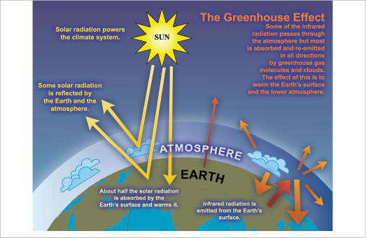
Earth’s “Heat-trapping Blanket”
IPCC: http://www.ipcc.ch/publications_and_data/ar4/wg1/en/faq-1-3-figure-1.html

Slide 12
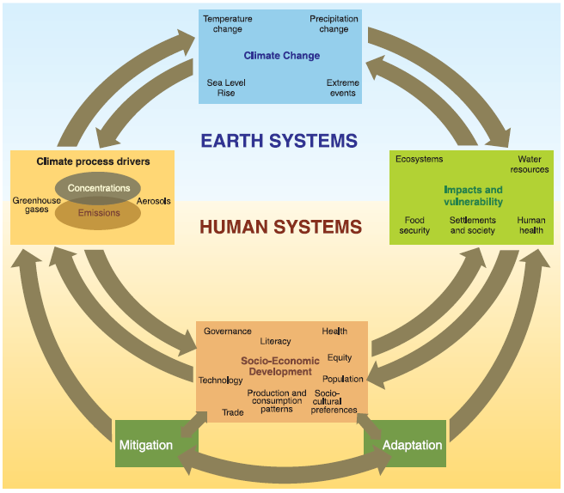
The Climate System

Slide 13
Is human-caused climate change occurring?
Better phrased as: “are human actions causing Earth’s climate to change in ways that differ enough from historical natural variation that we are likely to face impacts that humans find unattractive?”
Two subquestions
Is the climate changing?
Are humans the cause of the changes we are seeing?

Slide 14
Is the Climate Changing?

Slide 15
Is climate changing?
Yes. What’s the evidence?
Temperatures as measured are increasing over time, with various measurement types consistent with each other: thermometers / ice cores / corals / tree rings / land and ocean temps / satellites
Other direct indicators that warming has occurred: glaciers / ice sheets / Arctic ice / sea level rise / date of river-ice breakup / precipitation changes
  CanNOT attribute single events to climate change but can attribute probability shifts to it
Indirect indicators of warming also consistent with warming: bird migration days / plant blooming days
Amount of warming appears to be outside natural variation
Rate of warming appears to be faster than natural variation

Slide 16
Multiple ways of measuring temperature increase
Thermometers for recent past – averaged across globe
Ice core records for long-range past
Corals and ocean sediments for long-range past
Tree rings for medium-range past
Satellites for present and future
Wherever these methods overlap, good consistency
Where they measure different things, good consistency

Slide 17
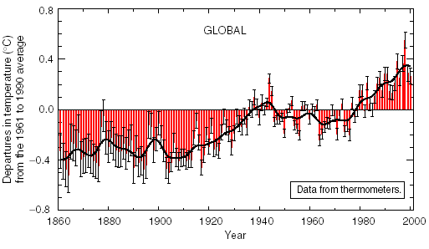
Thermometer Record for Past 140 Years
Source: Intergovernmental Panel on Climate Change. 2001. Climate change 2001: the scientific basis, summary for policymakers (a report of Working Group I of the Intergovernmental Panel on Climate Change). Geneva: Intergovernmental Panel on Climate Change, 3.

Slide 18
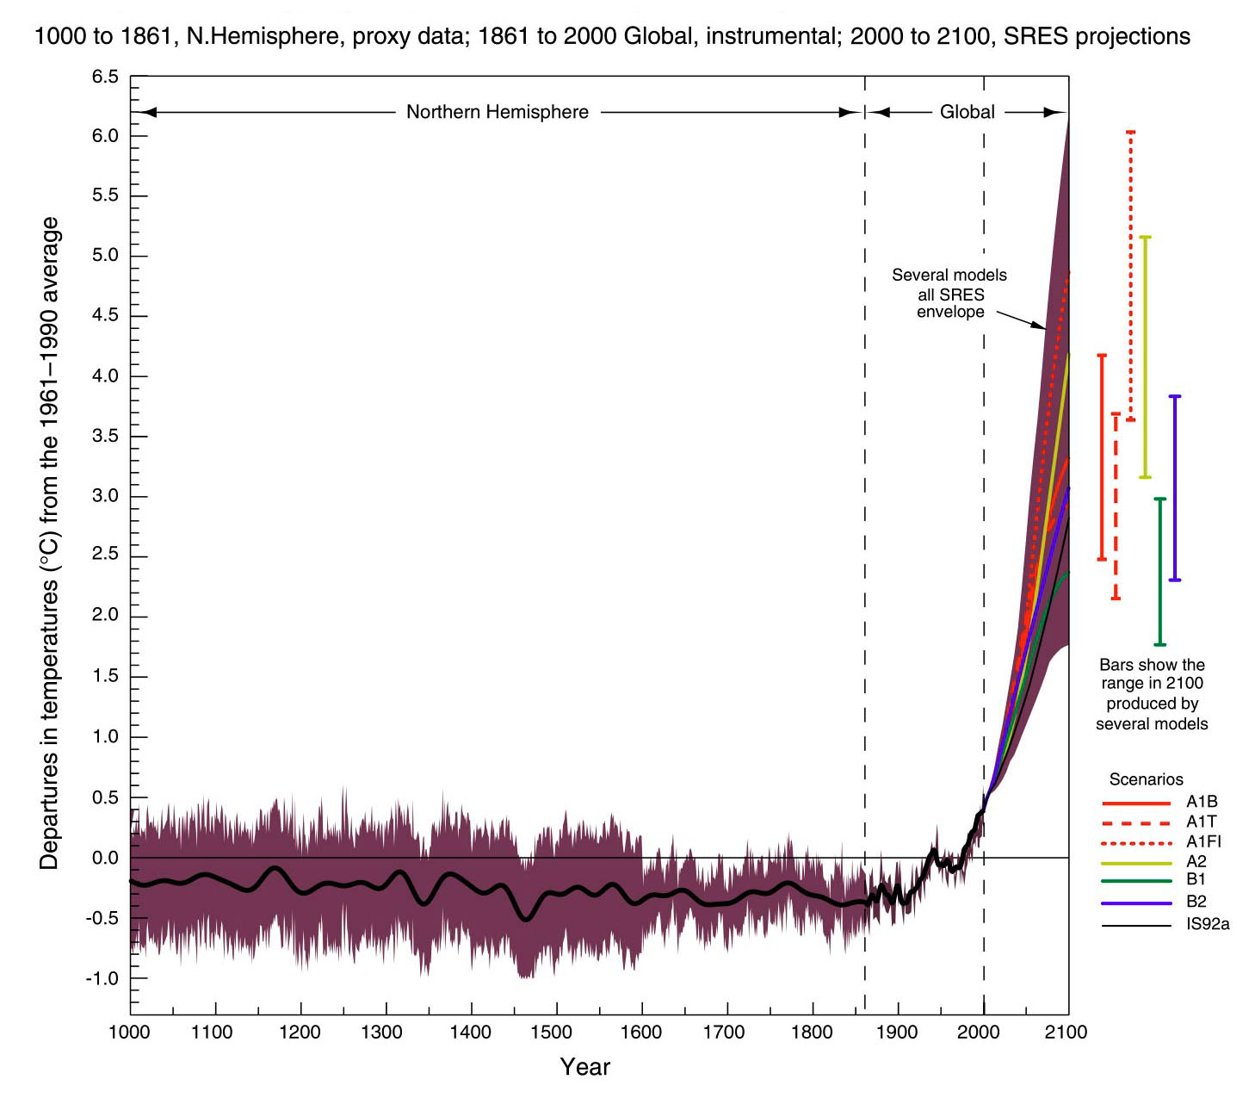
Ice Core Record for Past 1000 Years
Source: Intergovernmental Panel on Climate Change. 2001. Climate change 2001: the scientific basis, summary for policymakers (a report of Working Group I of the Intergovernmental Panel on Climate Change). Geneva: Intergovernmental Panel on Climate Change, 3. At: http://www.ipcc.ch/present/cop65/johnhoughton.ppt

Slide 19
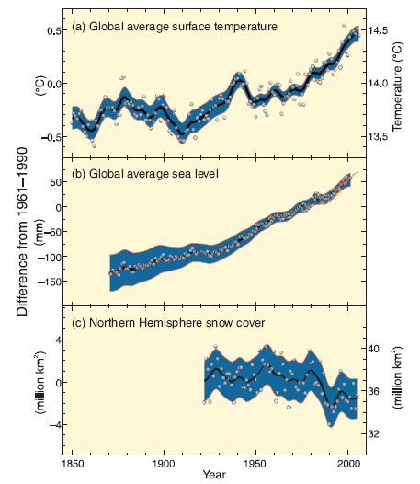
Multiple locations of warming
“Warming of the climate system is unequivocal, and since the 1950s, many of the observed changes are unprecedented over decades to millennia. The atmosphere and ocean have warmed, the amounts of snow and ice have diminished, sea level has risen, and the concentrations of greenhouse gases have increased” (IPCC, 2013).

Slide 20
Other direct indicators of warming
Precipitation: Changing patterns
Glaciers: Receding
Sea levels: Rising
Sea ice : Declining
River ice breakup: Earlier
Extreme climate events: More frequent

Slide 21
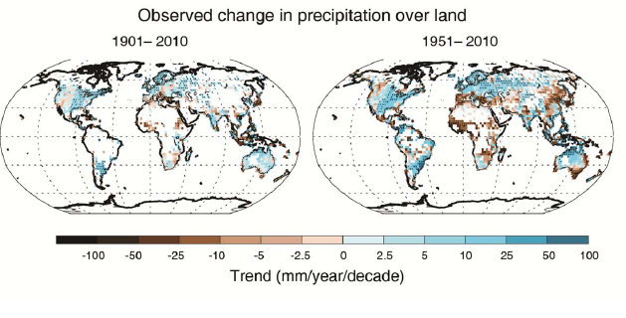
Precipitation: Changing patterns
Source: IPCC, 2013

Slide 22
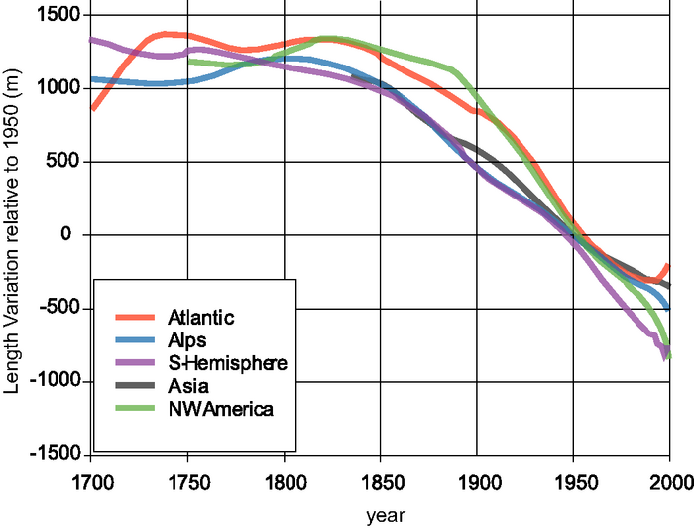
Glaciers: Receding
Greenland glacier loss – long time trend of one case
Glacier loss pictures – numerous cases of same phenomenon
IPCC: http://www.ipcc.ch/publications_and_data/ar4/wg1/en/figure-4-13.html

Slide 23
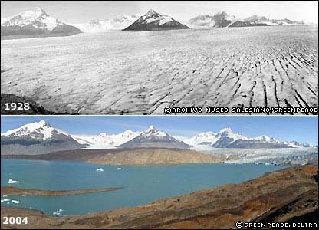
Glaciers: Argentina
http://news.bbc.co.uk/2/shared/spl/hi/picture_gallery/05/sci_nat_how_the_world_is_changing/html/1.stm

Slide 24
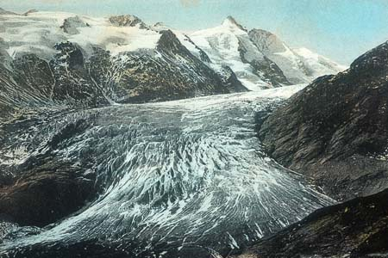
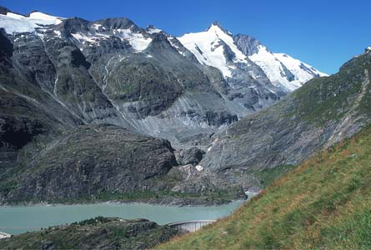
Glaciers: Austria
Kärnten, Austria
Source: Gesellschaft für ökologische Forschung e.V. 2002. Das gletscherarchiv. http://www.gletscherarchiv.de/. Accessed on: 15 January 2003.

Slide 25
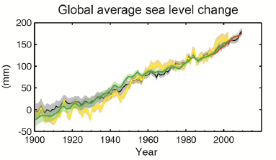
Sea levels: Rising
Source: IPCC, 2013: “The rate of sea level rise since the mid-19th century has been larger than the mean rate during the previous two millennia.”

Slide 26
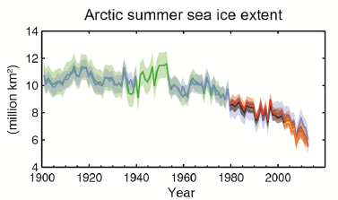
Sea ice: Declining
Arctic sea ice loss 1900-201o – long time trend of large phenomenon (~3.5%/decade)
changes in BAntarctic sea ice loss – “little evidence of long-term changes in … max or min ice extent”

Slide 27
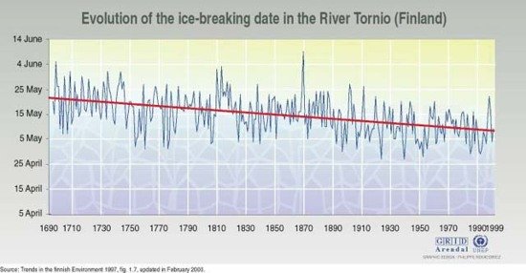
River ice breakup: Earlier

Slide 28
River ice breakup: Columbia River
Colubmia River froze over in: 1830, 1833, 1840, 1842, 1847, 1849(2x), 1856, 1875, 1862, 1868, 1884, 1885, 1888, 1890, 1891, 1894, 1896, 1907, 1909, 1916, 1919, 1930 *
Picture: Hood River, Oregon, W. D. Rogers, 1/17/1907; Oregon Historical Society Photo OrHi 35431 (http://librarycatalog.ohs.org/)
Columbia “generally freezes up once in the winter” from a trial in 1882 at http://books.google.com/books?id=wZA8AAAAIAAJ (p. 1393)
*Data on freezes compiled from: http://www.pacificcohistory.org/columbia.htm; http://historyink.com/results.cfm?keyword=Weather&searchfield=topics; and http://www.nwmapsco.com/ZybachB/Thesis/05-081_Chapter_3b.pdf (p. 86)

Slide 29
Extreme climate events: expected to be more frequent
Expectation of more frequent and bigger:
storms // droughts // floods
All these occur regularly anyway, so these are about increased likelihood, which is more uncertain
  “No clear trend in … tropical cyclones” (IPPC, 2007).
  “Insufficient evidence to determine whether trends exist in … small-scale phenomena such as tornadoes, hail, lightning and dust storms” (IPPC, 2007).
No single event attributable to warming but can attribute changes in probability

Slide 30
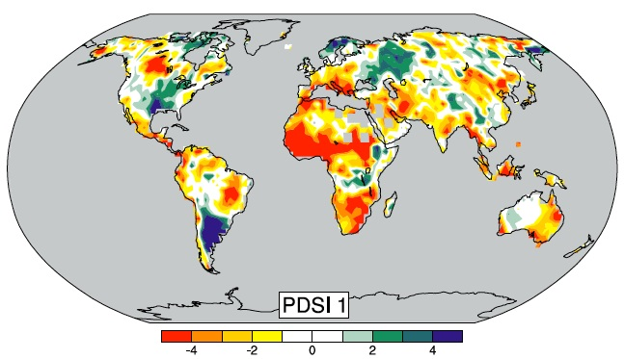
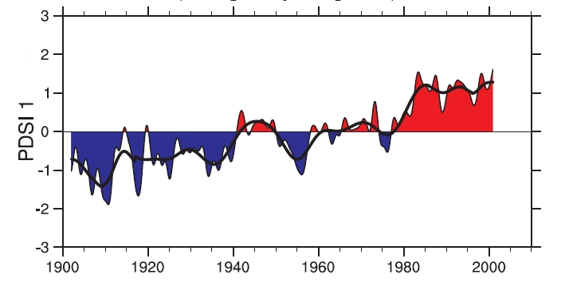
Droughts – more frequent
Palmer Drought Severity Index
-3 = severe drought; -4 = extreme drought

Slide 31
Indirect indicators of warming
Changes in biological systems
Birds, butterflies, mammals migrating earlier in year
Plants blooming earlier in year
Animals and plants “moving”: observed higher in altitude or latitude than previously

Slide 32
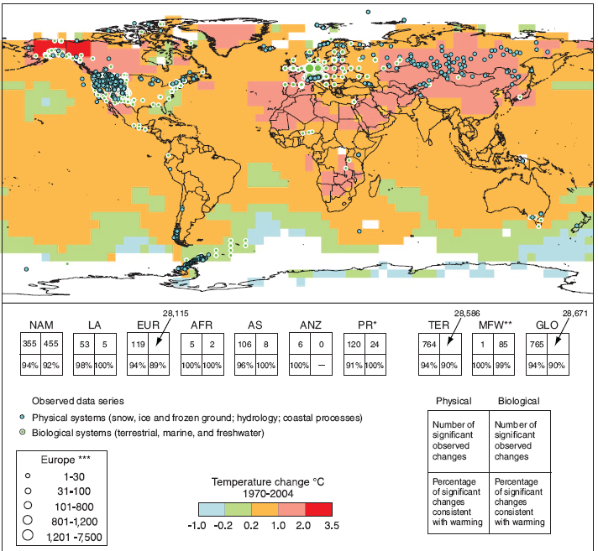
Observed effects of climate changes
“Of the more than 29,000 observational data series, from 75 studies, that show significant change in many physical and biological systems, more than 89% are consistent with the direction of change expected as a response to warming” IPCC, 2007)

Slide 33
QUESTIONS?

Slide 34
Are humans causing the changes we are seeing?

Slide 35
Summary of humans as causes argument
Higher levels of human behaviors that lead to increased emissions of known climate-changing gases
correlate with
Higher atmospheric concentrations of those gases which
correlate with
Higher temperatures (and “as predicted” temperatures
and do not correlate with
Natural causes of higher temperatures alone
and are explainable
By well-known theories of physics and chemistry

Slide 36
Why should we think its humans?
Physics and chemistry of planet temperature known
Earth in equilibrium; small changes can change that
Increases in culprit chemicals seen in atmosphere
Culprit chemicals come from known human activities
Temperature changes coincide with concentration and human activity increases
Models match data only if natural factors and human factors included

Slide 37
Physics and chemistry of planet temperature known
Basic physics and chemistry say more GHGs, more temperature
Record shows CO2-temperature correlation

Slide 38
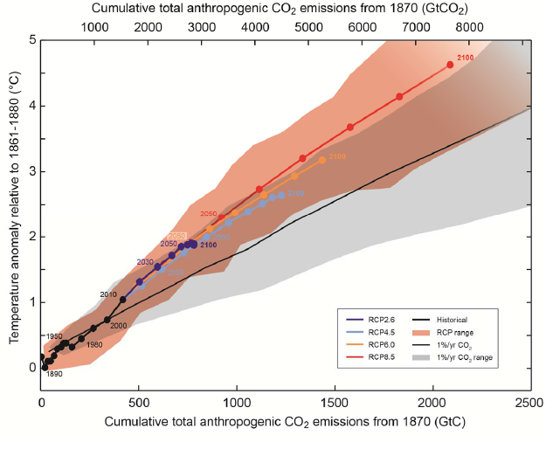
CO2-temperature correlation
Source: IPCC, 2013

Slide 39
Earth in equilibrium: small changes can change that
CO2 and CH4 are VERY small fraction of atmosphere
N2: 78%; O2: 21%; Ar: 1%; CO2: 0.04%; CH4: 0.0002%
Small changes in inputs can make big changes in outputs.
  Delicate balance is in equilibrium: 500 pounds on each side, grain of sand can unbalance.
  Human body: 5 beers = (5* 12 * .05) 3 ounces of alcohol can influence a 2400 ounce person (150 pounds)

Slide 40
Increases in culprit chemicals seen in atmosphere
CO2: Atmospheric concentrations over past 10,000 years between 260 and 280; Currently at about 400 and on a steady trajectory upward in last 60 years (Mauna Loa)
CH4: Atmospheric concentrations before 1800 at 0.8 ppm; Began increasing in 1800 and now at 1.75 ppm (more than 2x)
No other explanations of these changes

Slide 41
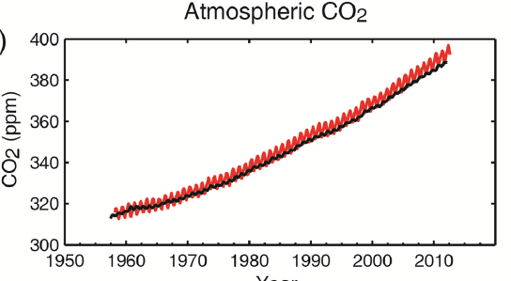
CO2 measured at Mauna Loa
Source: IPCC, 2013

Slide 42
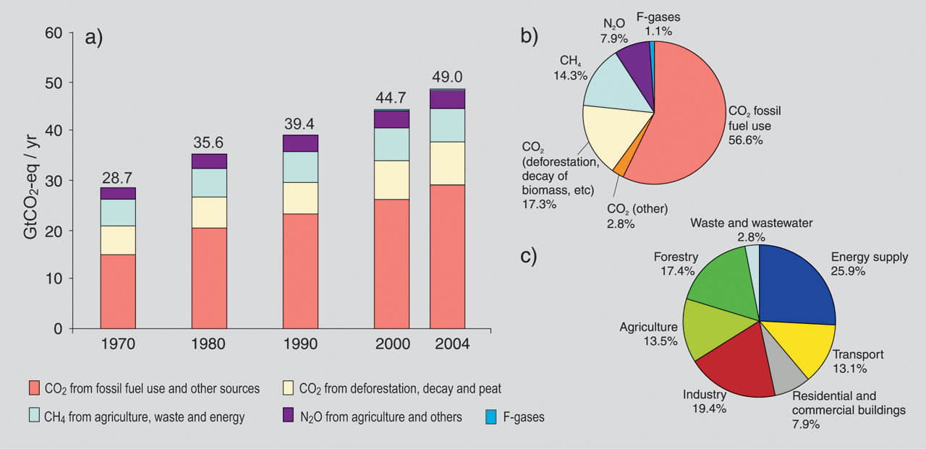
Culprit chemicals come from known human activities
IPCC: http://www.ipcc.ch/graphics/syr/fig2-1.jpg

Slide 43
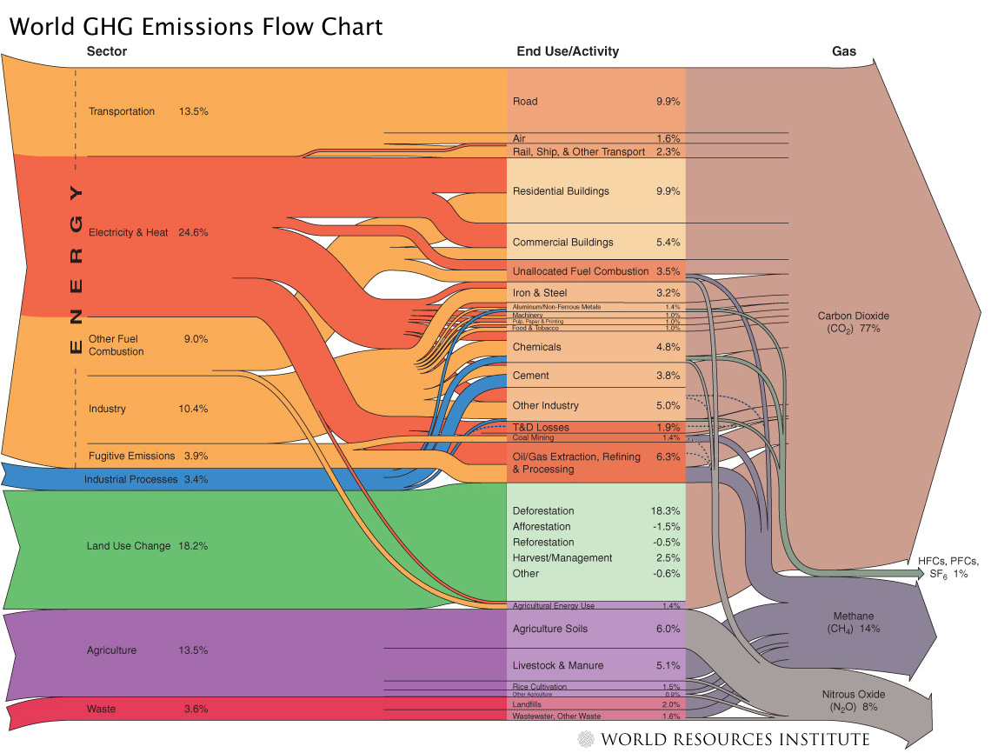
Culprit chemicals come from known human activities
Source: World Resources Institute: http://www.wri.org/image/view/9529/_original

Slide 44
Basics of that chart:
3 main greenhouse gases & their 4 sources
Human GHG emissions: up 70% from 1970-2004
75% of problem: Carbon Dioxide (CO2)
  Fossil fuel use for transport, electricity, heating, cooling, manufacturing (55%)
  Deforestation (20%)
15% of problem: Methane (CH4)
  Livestock and manure
  Rice cultivation
8% of problem: Nitrous Oxide (N2O)
  Agriculture fertilization

Slide 45
Temperature changes coincide with concentration and human activity increases
Most coincide with industrial revolution around 1850
Glacier record – decline starts in 1850
Sea level -- increase starts in 1850
Since 1900:
  1.5F (0.7C) rise in global surface air temp
  30% increase in CO2
  150% increase in CH4 (methane)
Happening on HUMAN timescales, not ecological ones
  If earth were 100 years old
  Then man emerges ~ 1 day ago
  Recorded history started 2 hours ago
  Industrial revolution started 2 minutes ago

Slide 46
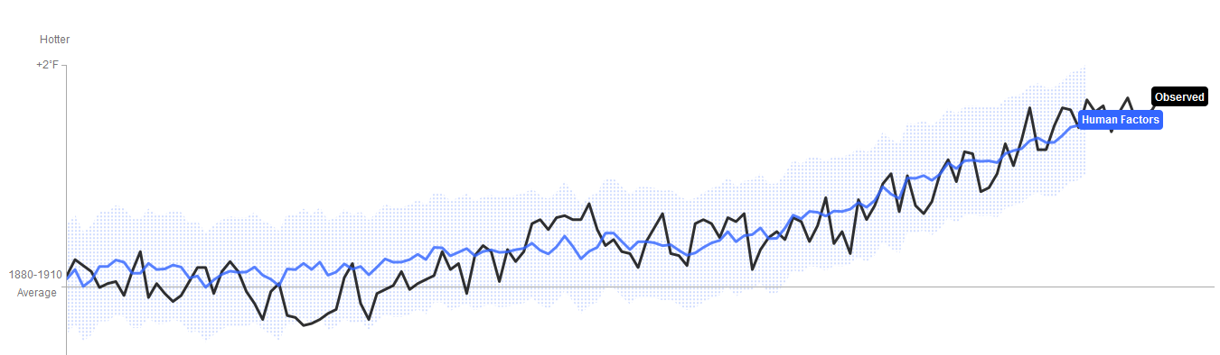
Models match data only if natural factors and human factors included
5 natural causes of CC, but don’t explain CHANGES
  Orbit of earth
  Solar flares
  Volcanoes
  Tectonic processes
  Internal variability of climate change
Graphic representation of matching: Computer models match observed temps only with natural & human

Slide 47
Strengthening evidence that humans are causing it: IPCC Reports
FAR: 1990: unequivocal detection of enhanced greenhouse gas effect not likely for decade or more
SAR: 1995: balance of evidence suggests a discernible human influence on global climate
TAR: 2001: new, stronger evidence that most warming observed of last 50 years is due to humans
AT4: 2007: most observed increase in global average temps since 1950 is likely due to anthropogenic greenhouse emissions
AT5: 2013: extremely likely that human influence has been the dominant cause of the observed warming since the mid-20th century
Slide courtesy of Greg Bothun, U of Oregon

Slide 48
Summary of humans as causes argument
Higher levels of human behaviors that lead to increased emissions of known climate-changing gases
correlate with
Higher atmospheric concentrations of those gases which
correlate with
Higher temperatures (and “as predicted” temperatures
and do not correlate with
Natural causes of higher temperatures alone
and are explainable
By well-known theories of physics and chemistry

Slide 49
QUESTIONS?

