Slide 1
Assignment 2: Due Thurs, next week Drivers of climate change
Using the charts in Excel workbook identify 2 interesting patterns related to climate change emissions
Example: of 6 highest, 5 are developing but 1 isn’t
Using other graphs/charts in the Excel workbook, find data that explains the pattern you identified
Look at what things “go with” the pattern
WRITE AS AN ESSAY, not answers to questions
Use headings and use citations, if possible
In 1000 words or less explain the pattern you observe.
Include graphs of your data if you want to
Ask questions now please!

Slide 2
Causes (“Drivers”) of Climate Change
Part I

Slide 3
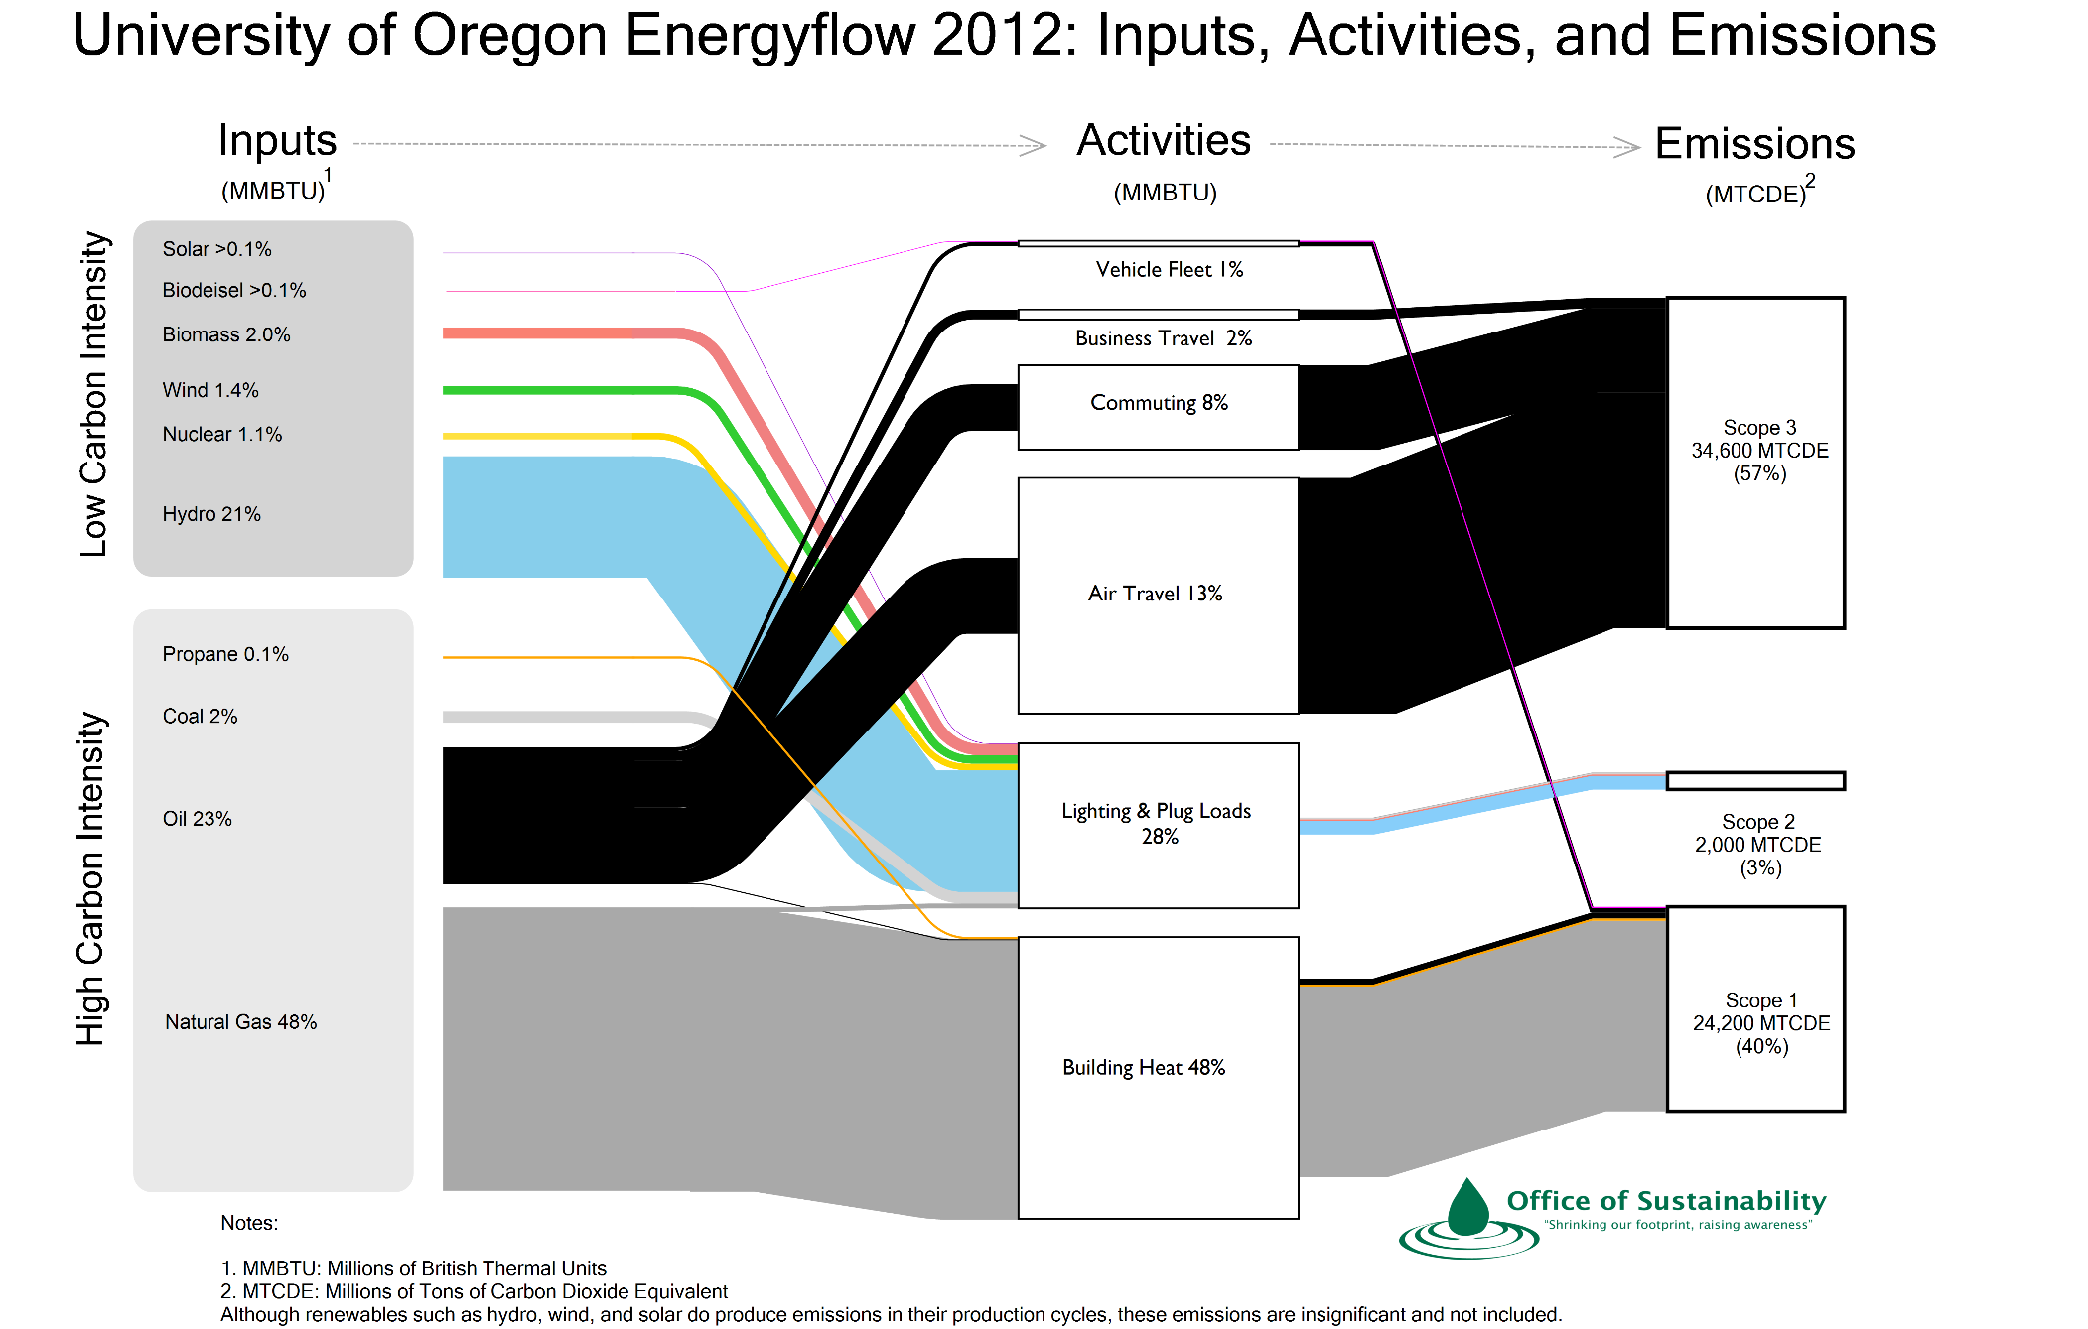
Source: https://cpfm.uoregon.edu/sites/cpfm2.uoregon.edu/files/uoenergy2012_highquality.png

Slide 4
Drivers of human impacts
IPAT (Ehrlich & Holdren, 1972)
Impact = Population * Affluence * Technology
Kaya:
CO2 = Pop’n * ($GDP/Pop’n) * (Energy/$GDP) * (CO2/Energy)
CO2 = Economic Growth * Technology Change .
How much CO2 grows depends on:
Economic Growth: Population Growth * Income Growth
Technology Change: Energy intensity * Carbon intensity

Slide 5
The causes of climate change The IPAT equation

Slide 6
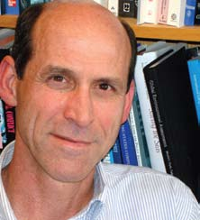
The causes of climate change The IPAT equation

Slide 7
The causes of climate change The IPAT equation
I chose to have children and have two (P)
I want them to have a better life than me (A)
I ask for raises (A)
When I receive them, I spend them (A, T)
I drive too far (and too fast) to work (T)

Slide 8
My Footprint

Slide 9
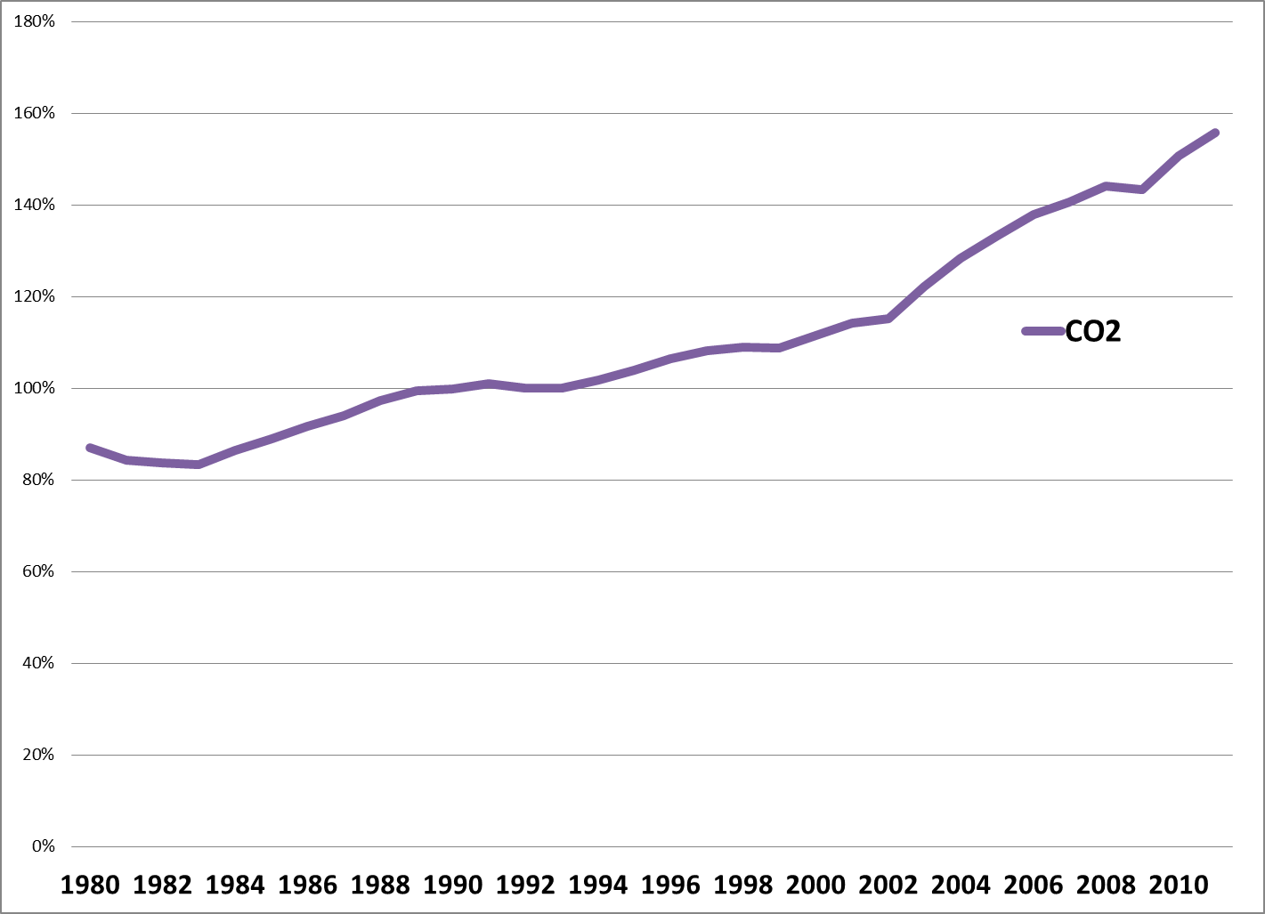
Growing at 2.4% per year since 1996
Emissions Double by 2041
(Oregon: 1.6% per year)
Sources: Calculated based on Global: World Development Indicators, 2010;
Oregon: http://www.oregon.gov/ENERGY/GBLWRM/Oregon_Gross_GhG_Inventory_1990-2005.htm ; http://www.oregon.gov/DAS/OEA/docs/demographic/pop_components.xls ; and http://www.bea.gov/regional/gsp/

Slide 10
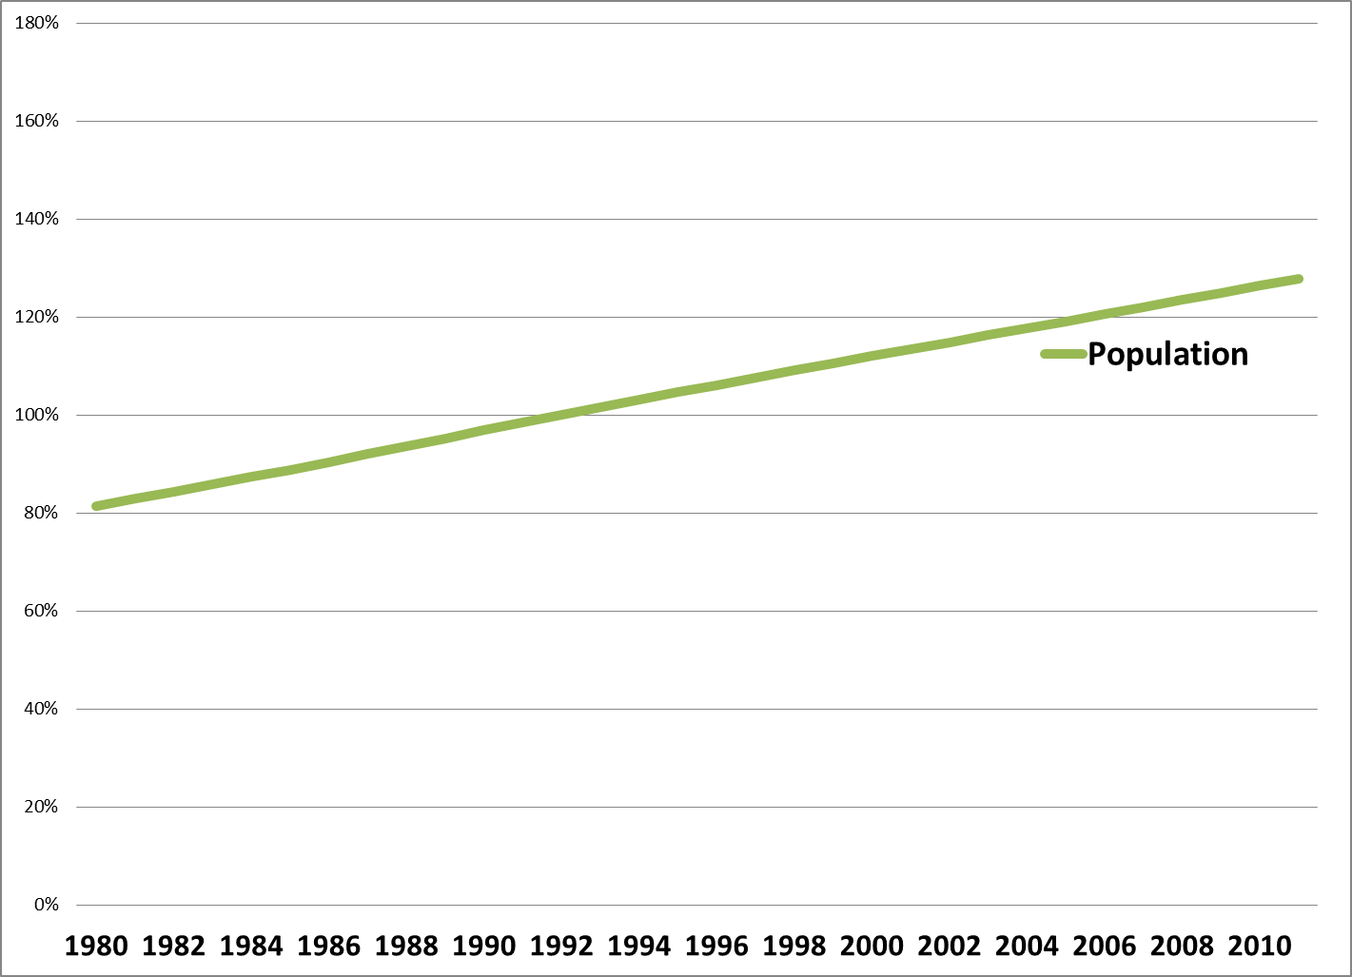
Growing at 1.3% per year since 1996
Doubles by 2065, all else equal
(Oregon: 1.7% per year)
Sources: Calculated based on Global: World Development Indicators, 2010;
Oregon: http://www.oregon.gov/ENERGY/GBLWRM/Oregon_Gross_GhG_Inventory_1990-2005.htm ; http://www.oregon.gov/DAS/OEA/docs/demographic/pop_components.xls ; and http://www.bea.gov/regional/gsp/

Slide 11
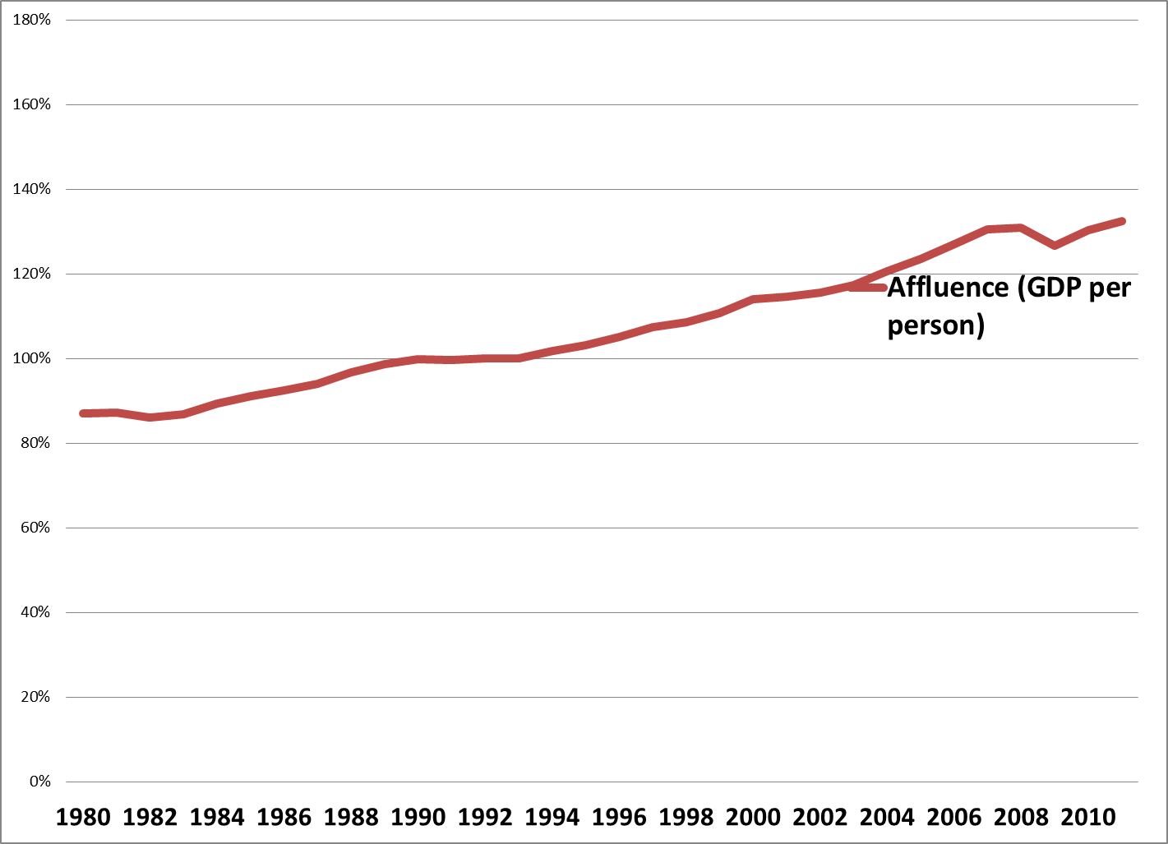
Growing at 1.8% per year since 1996
Doubles by 2050, all else equal
(Oregon: 4.3% per year)
Sources: Calculated based on Global: World Development Indicators, 2010;
Oregon: http://www.oregon.gov/ENERGY/GBLWRM/Oregon_Gross_GhG_Inventory_1990-2005.htm ; http://www.oregon.gov/DAS/OEA/docs/demographic/pop_components.xls ; and http://www.bea.gov/regional/gsp/

Slide 12
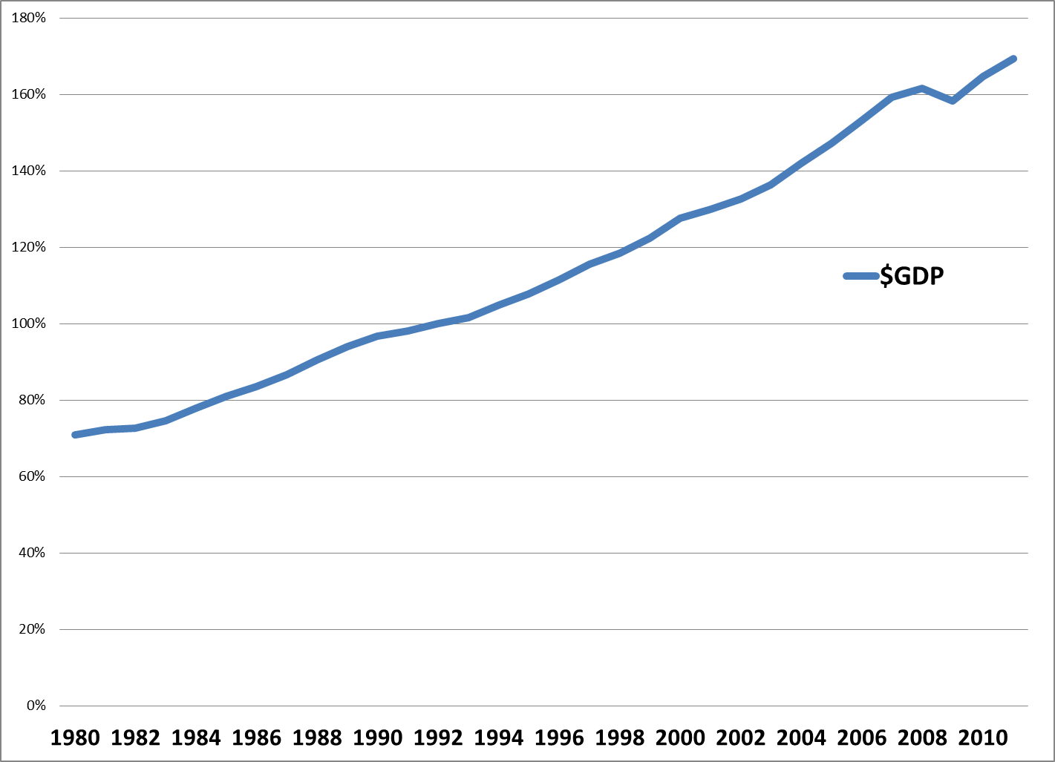
Growing at 3.1% (1.3+1.8) per year since 1996 Doubles by 2033, all else equal
(Oregon: 6.0% per year)
Sources: Calculated based on Global: World Development Indicators, 2010;
Oregon: http://www.oregon.gov/ENERGY/GBLWRM/Oregon_Gross_GhG_Inventory_1990-2005.htm ; http://www.oregon.gov/DAS/OEA/docs/demographic/pop_components.xls ; and http://www.bea.gov/regional/gsp/

Slide 13
Doubling CO2 emissions
We will double CO2 emissions by
2033: assuming current population & affluence growth rates (3.1%) continue
To reduce emissions requires technology improvements that are greater than 3.1% per year
So, what about technology?

Slide 14
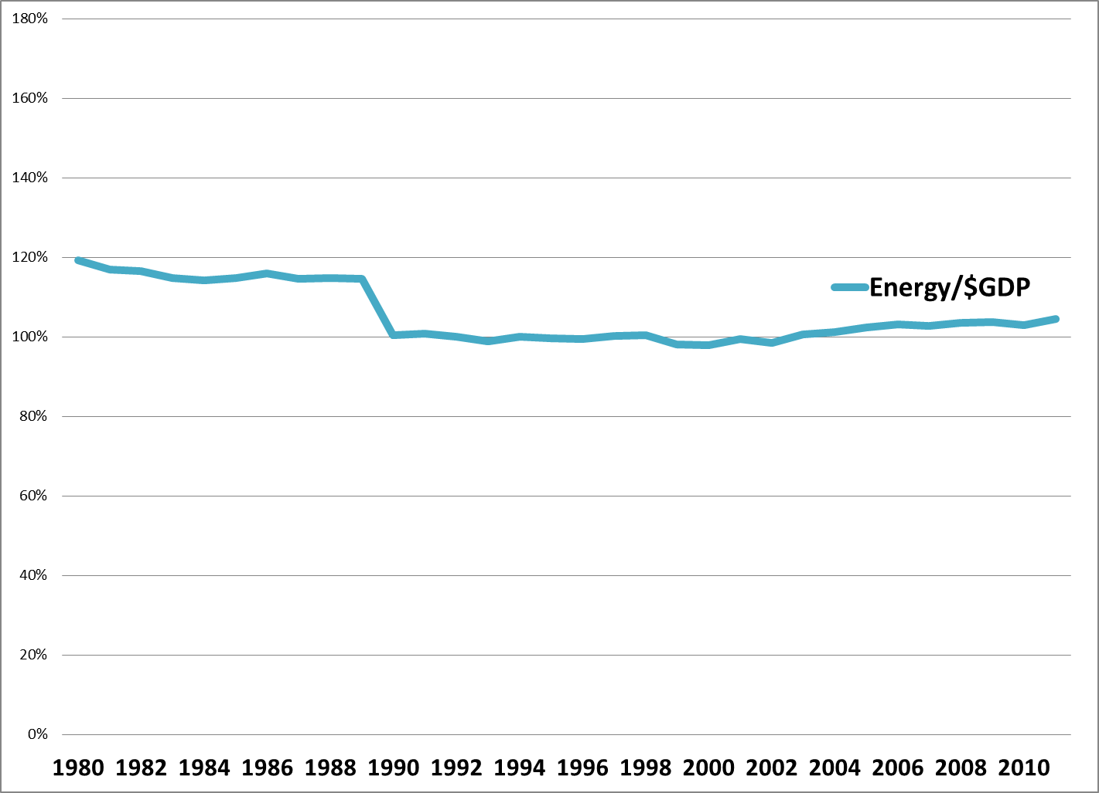
Sources: Calculated based on Global: World Development Indicators, 2010;
Oregon: http://www.oregon.gov/ENERGY/GBLWRM/Oregon_Gross_GhG_Inventory_1990-2005.htm ; http://www.oregon.gov/DAS/OEA/docs/demographic/pop_components.xls ; and http://www.bea.gov/regional/gsp/

Slide 15
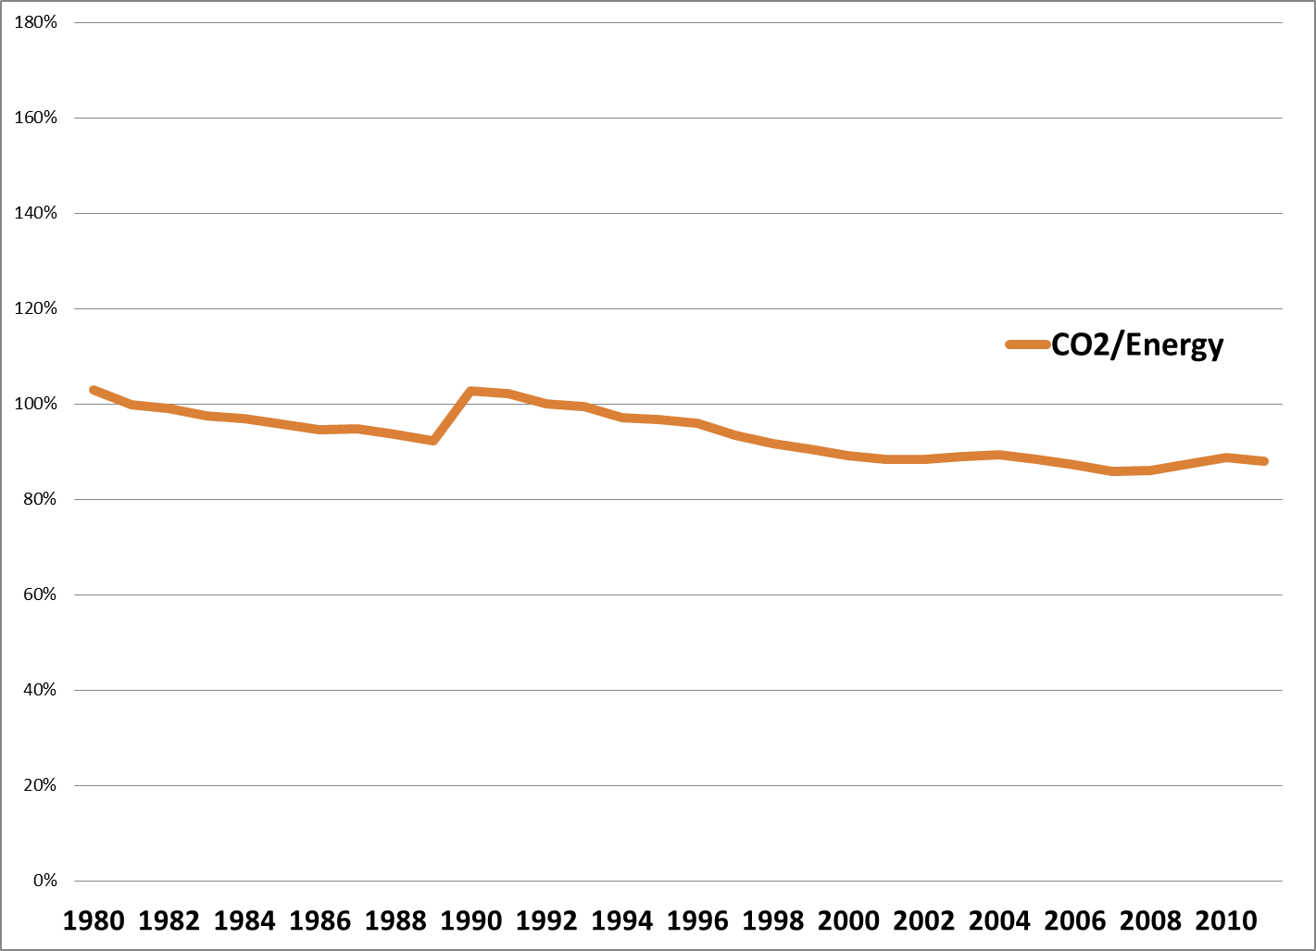
Sources: Calculated based on Global: World Development Indicators, 2010;
Oregon: http://www.oregon.gov/ENERGY/GBLWRM/Oregon_Gross_GhG_Inventory_1990-2005.htm ; http://www.oregon.gov/DAS/OEA/docs/demographic/pop_components.xls ; and http://www.bea.gov/regional/gsp/

Slide 16
Halving CO2 emissions will be hard
If we don’t address population & affluence, current CO2 emissions will double by 2033
If we eliminate population AND affluence growth, technology improvements take until 2110 to cut emissions in half
In short:
0.7% ≠ 3.1% per year

Slide 17
Summary: Annualized Growth Rates
 | Global | Oregon
CO2 Trends doubles CO2 by: | 2.4% 2041 | 1.6% 2055
Population | 1.3% | 1.7%
Affluence | 1.8% | 4.3%
Population*Affluence | 3.1% | 6.0%
Technology | -0.7% | -4.2%

Slide 18
Creating a Model of Climate Drivers
What factors lead to P, A, and T?
Personal factors, as identified above
Structural factors
Understand processes that lead to emissions to identify points for “policy intervention”

Slide 19
Creating a Model of Climate Drivers
???
Population
(people)
???
???
???
Affluence
($GDP/person)
Impact
(CO2 Emissions)
???
???
???
Technology
(CO2/$GDP)
???
???

Slide 20
Creating a Model of Climate Drivers
Structural factors
Values related to “what’s a good life”
Kids
Stuff
Freedom
Infrastructure: US: 20 tons/yr; EU 10 tons/yr
What factors influence the rate of population growth?

Slide 21
Creating a Model of Climate Drivers
???
Population
(people)
???
???
???
Affluence
($GDP/person)
Impact
(CO2 Emissions)
???
???
???
Technology
(CO2/$GDP)
???
???

Slide 22
Determinants of Population Growth
Discussion
What are the determinants?
Why is it so hard to change?

Slide 23
Religion and Population
Rosling does not connect this to climate change but try to do so
Rosling on population growth

Slide 24
Changing Population Growth
Some policies do influence population size, fertility
Educating women
Chinese one child policy (China 1.7/woman)
French pro-natalist policy (France 1.98/woman vs. UK 1.66/woman)
Catholic position on contraception
So do social norms
“When are you going to have kids?”
“I wonder why they don’t have any kids?”
“Congratulations on your new baby!”
“I want to live a nice long life.”
Yet population appears “off limits” politically (not mentioned at Copenhagen)
Sources: http://newedexcelgeography.blogspot.com/2008/01/france-pro-natalist-policy.html
http://www.vatican.va/holy_father/paul_vi/encyclicals/documents/hf_p-vi_enc_25071968_humanae-vitae_en.html

