Slide 1
Causes (“Drivers”) of Climate Change?
Part II

Slide 2
Summary: Annualized Growth Rates
 | Global | Oregon
CO2 Trends doubles CO2 by: | 2.4% 2041 | 1.6% 2055
Population | 1.3% | 1.7%
Affluence | 1.8% | 4.3%
Population*Affluence | 3.1% | 6.0%
Technology | -0.7% | -4.2%

Slide 3
Creating a Model of Climate Drivers
What factors lead to P, A, and T?
Personal factors, as identified above
Structural factors
Understand processes that lead to emissions to identify points for “policy intervention”

Slide 4
Creating a Model of Climate Drivers
???
Population
(people)
???
???
???
Affluence
($GDP/person)
Impact
(CO2 Emissions)
???
???
???
Technology
(CO2/$GDP)
???
???

Slide 5
Creating a Model of Climate Drivers
Structural factors
Values related to “what’s a good life”
Kids
Stuff
Freedom
Infrastructure: US: 20 tons/yr; EU 10 tons/yr
What factors influence the rate of population growth?

Slide 6
Creating a Model of Climate Drivers
???
Population
(people)
???
???
???
Affluence
($GDP/person)
Impact
(CO2 Emissions)
???
???
???
Technology
(CO2/$GDP)
???
???

Slide 7
Determinants of Affluence Growth
Discussion
What are the determinants?
Why is it so hard to change?
How does it relate to CO2 emissions?

Slide 8
Environmental Kuznets Curve The Graph
Graph of the relationship between increasing affluence (income: GDP per capita) and pollution levels
What do you expect it to be?

Slide 9
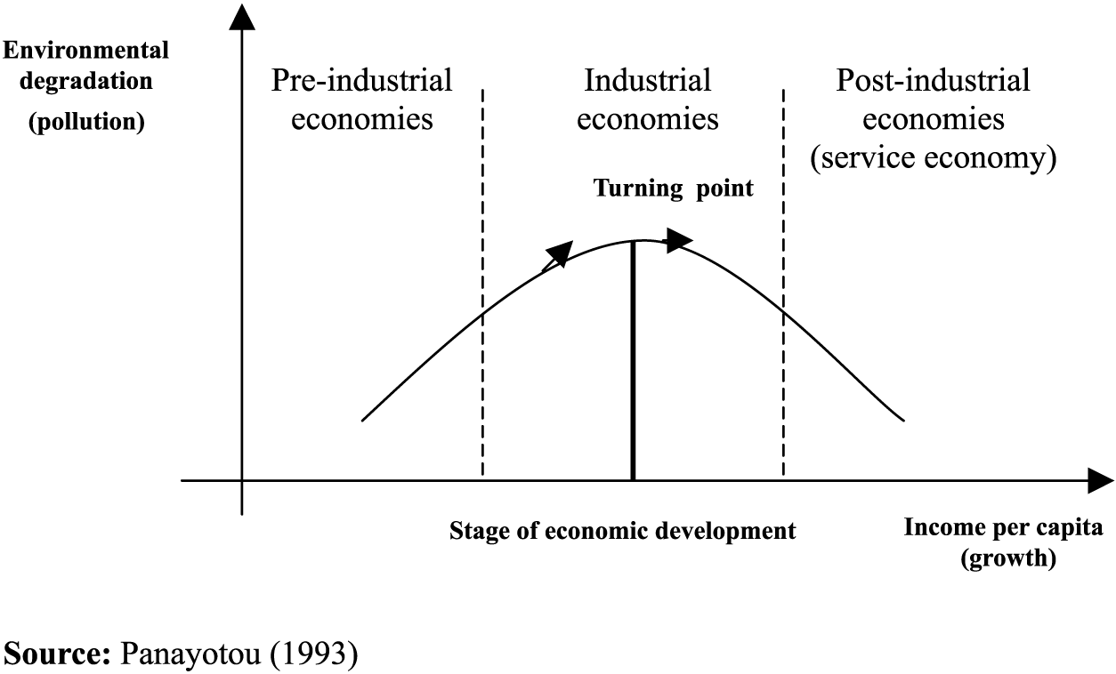
Environmental Kuznets Curve The Graph

Slide 10
Environmental Kuznets Curve The Logic
As people get richer, three competing things happen:
People have more money and so buy more stuff and so pollution/emissions increase
But, after a certain point, this is more than offset by the fact that as people have more money, they start caring more about the environment and demand government protection of it
And, more money correlates with service economy which “displaces” or “offshores” the pollution

Slide 11
Changing Affluence Growth
Some policies do influence consumption patterns
Buddhist monks
Jewish observance of Shabbat
Mormon tithing
Voluntary simplicity: “frugality of consumption”
So do social norms
“More, More, More said the baby.”
“I want a better life for my kids.”
“I need a raise.”
“I need a vacation.”
Yet affluence also appears “off limits” politically (though see “Confronting Consumption”)
Source: http://www.simpleliving.net/voluntary_simplicity_part_1.asp

Slide 12
Creating a Model of Climate Drivers
???
Population
(people)
???
???
???
Affluence
($GDP/person)
Impact
(CO2 Emissions)
???
???
???
Technology
(CO2/$GDP)
???
???

Slide 13
Determinants of Technology Growth
Discussion
What are the determinants?
Why is it so hard to change?
How does it relate to CO2 emissions?

Slide 14
The Jevons Paradox
Jevons Paradox: technological progress that increases efficiency of a resource being used leads to MORE of that resource being used. “Technological improvements that increased the efficiency of coal-use led to the increased consumption of coal [and therefore] could not be relied upon to reduce fuel consumption” (Wikipedia)
York (UO Sociology Prof) showed in most countries for past 50 years, each unit of nonfossil-fuel energy displaced less than ¼ unit of fossil-fuel energy and each unit of nonfossil-fuel electricity displaced less than 1/10th” (York 2013).

Slide 15
Jevons Paradox The Logic
As technology becomes more efficient, the price of that technology declines and two competing things happen.
Pollution per unit goes down
Number of units used goes up, because they are cheaper
York’s point is that
We might expect people to shift to renewables but actually, it lowers the overall prices of energy and we end

Slide 16
Changing Behavior: How Hard Can It Be?
If I told you I had a new technology that could increase your car’s fuel efficiency by 20% and reduce your CO2 emissions by 20%, would you use it?
How much would you pay for it?

Slide 17
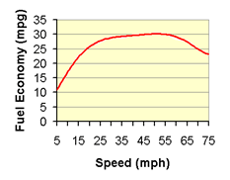
Changing Behavior: How Hard Can It Be?
It’s the gas pedal
Most people drive 75 mph on freeways
Slowing to 65 mph decreases emissions by ~10%
Slowing to 55 mph decreases emissions by ~20%
No law is required!
Source: http://www.fueleconomy.gov/feg/driveHabits.shtml

Slide 18
Which of these drivers are we addressing?

Slide 19
We are not addressing two of the drivers
Population - No
Affluence - No
Technology – Yes
I don’t think improving technology alone can get us there
Can we invent new technology?
If we do, can we get people to use it?

Slide 20
Population and affluence: the role of government
Population and affluence reflect deep-seated values
Democracies usually see values as inputs to government policy not targets of government policy
Democracies tend NOT to see “shaping values” as an appropriate role for government

Slide 21
Population and affluence: alternatives to government
Many people DO see “shaping values” as an appropriate role for other institutions
Religions
Families
Corporations
Social movements
Conscious communities

