Slide 1
Overview
Evaluating effectiveness
Montreal Protocol
Whaling treaty
Comparison of two regimes

Slide 2
Evaluating Effectiveness
Institutions/regimes/treaties can always be evaluated against TWO definitions of success
#1: “Was goal achieved?” Or “How close did institution come to achieving its goal?”
Compare actual behavior to goal
#2: “Did institution cause behaviors or outcomes different than would have occurred otherwise?”
Compare actual behavior to counterfactual

Slide 3
Let’s Make Up Counterfactuals
With your host
Ronald Mitchell

Slide 4
Montreal Protocol and Ozone Depleting Substances
Growth of the Antarctic ozone hole over 20 years, as observed by the satellite
Darkest blue areas represent regions of maximum ozone depletion.

Slide 5
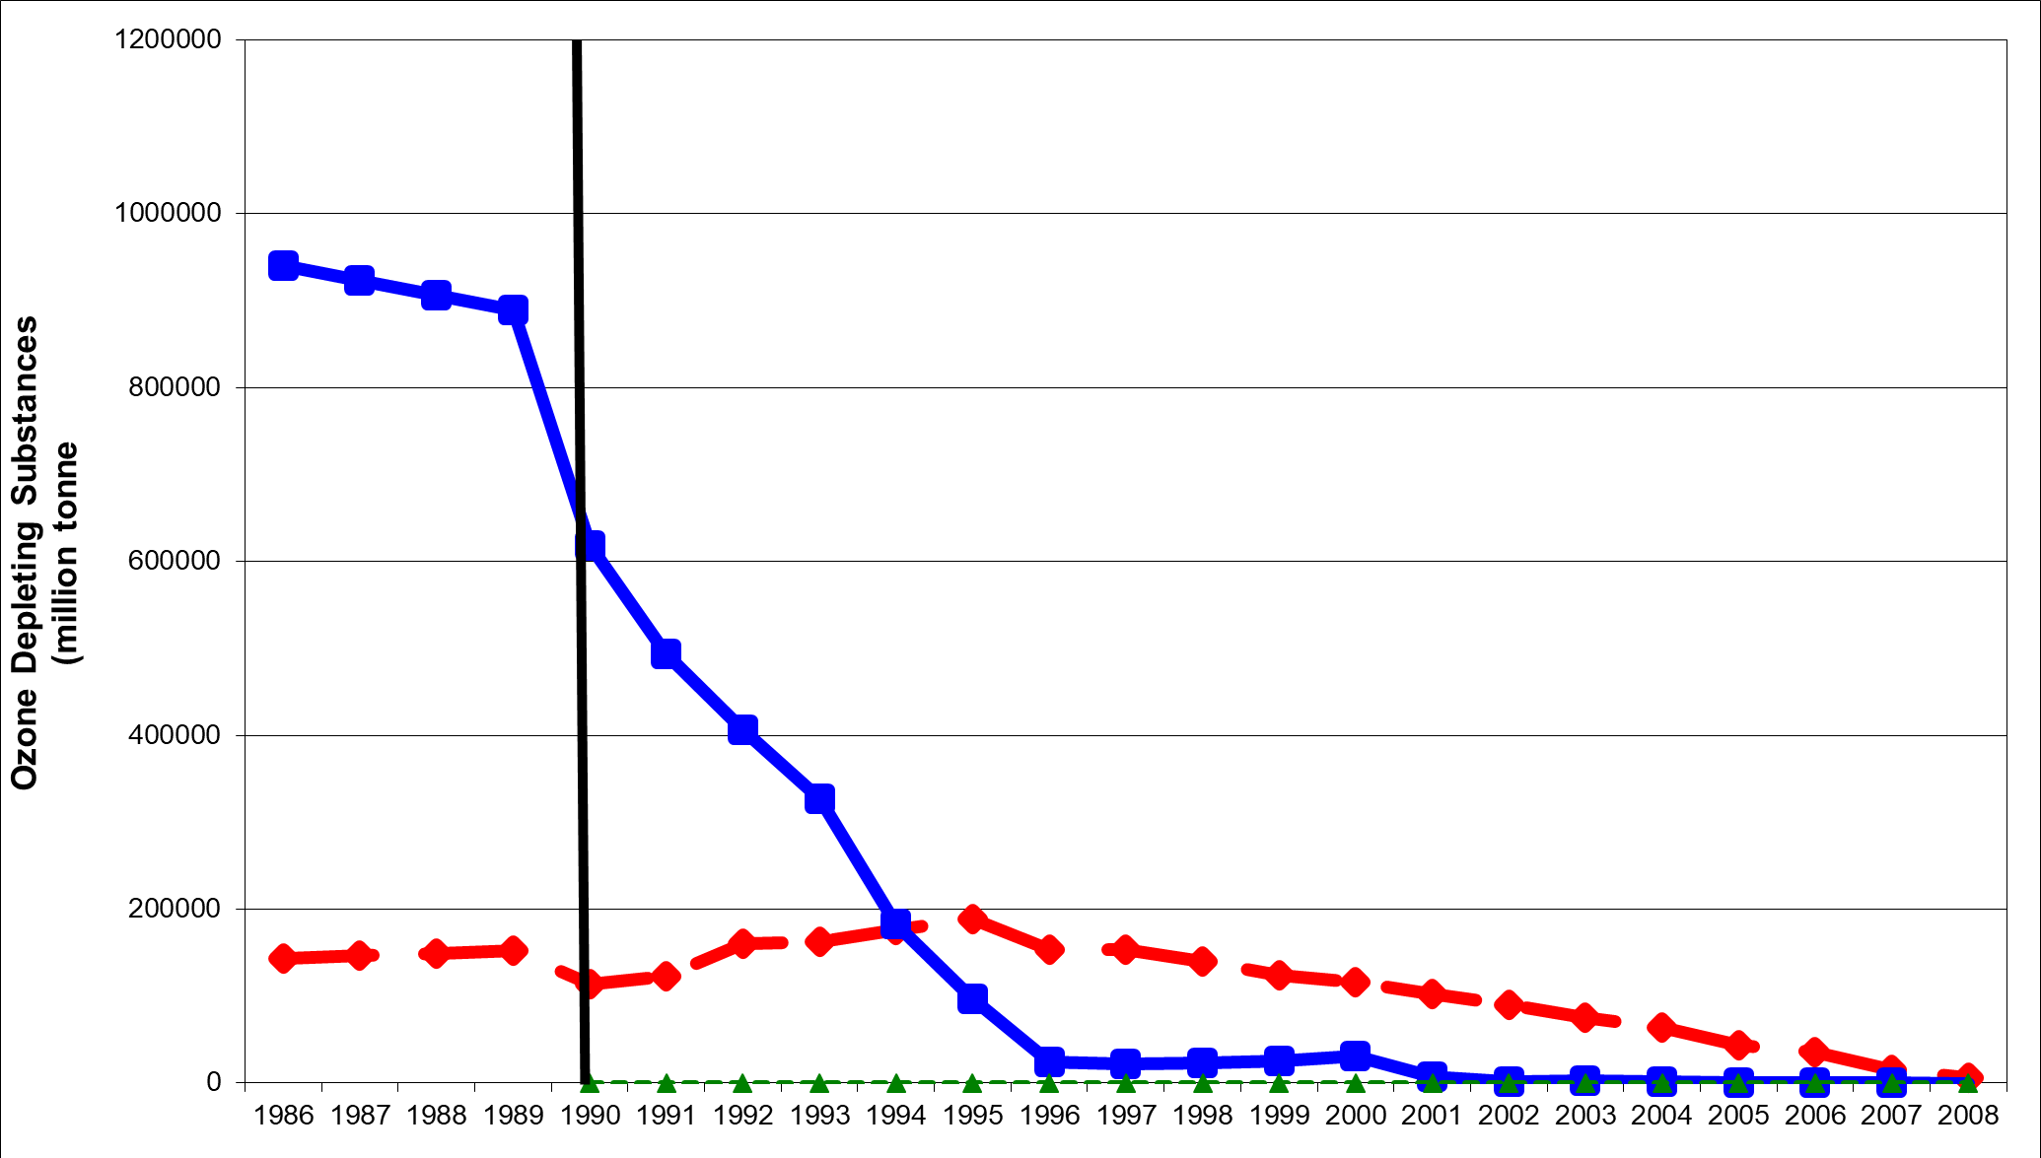

Slide 6
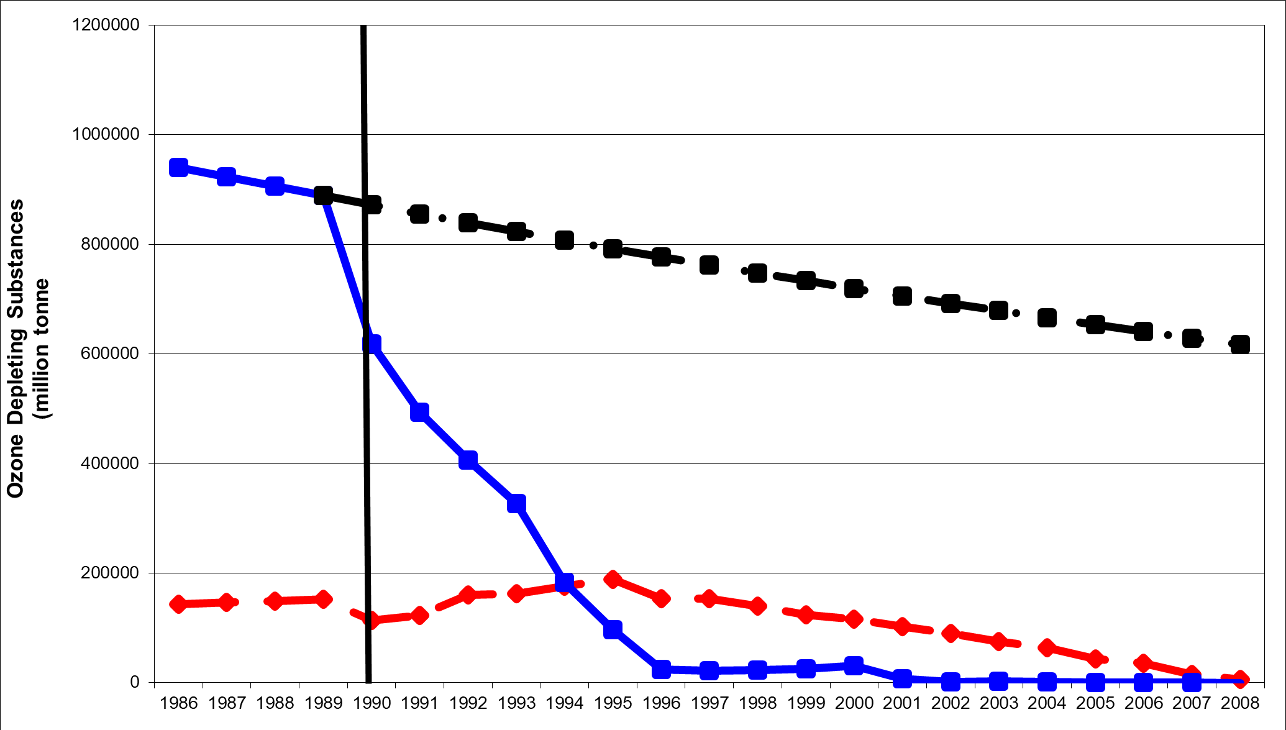
Counterfactual Based on Member’s Prior Behavior Implies Effect

Slide 7
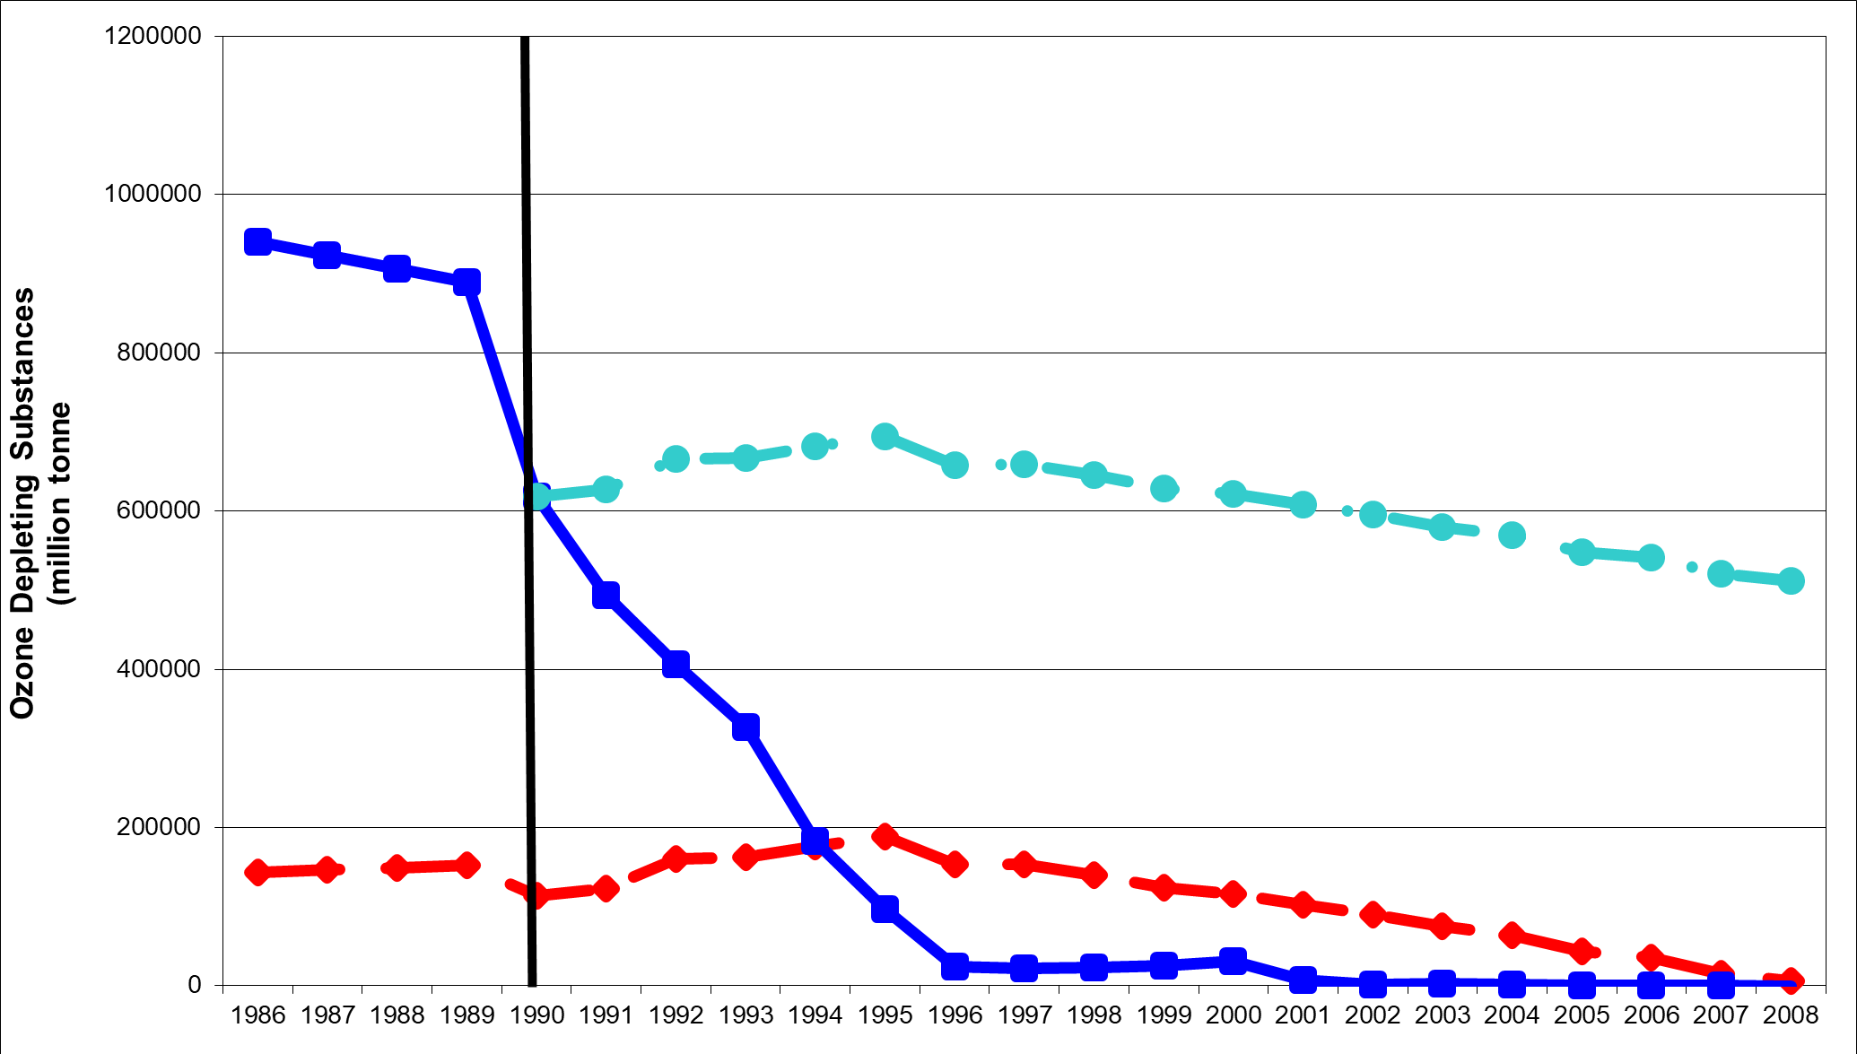
Counterfactual Based on NON-Member’s Post-Treaty Behavior Implies Treaty Effect

Slide 8
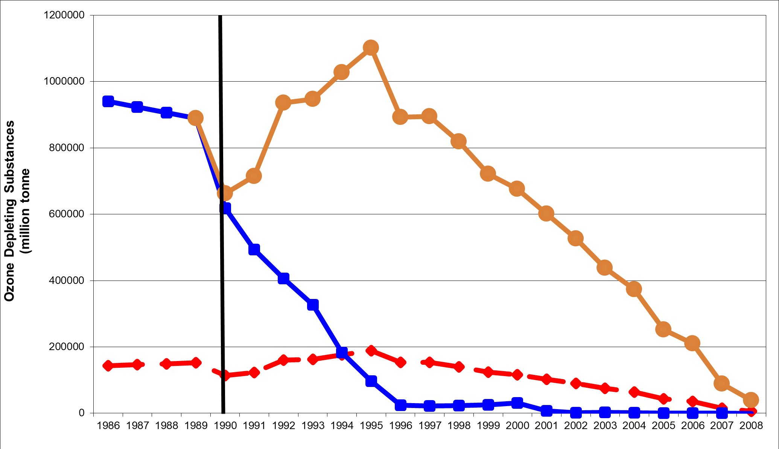
Counterfactual Based on NON-Member’s Post-Treaty Behavior Implies Treaty Effect

Slide 9
BUT Behavior Relative to Goal Implies NO Effect

Slide 10
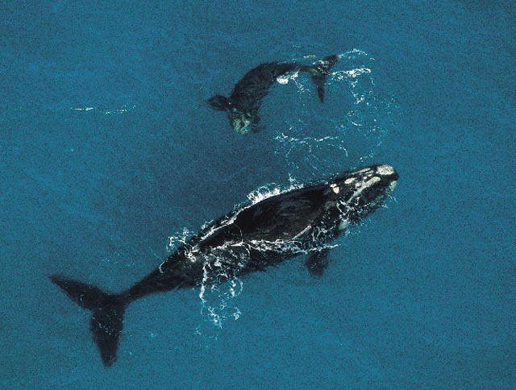
Whaling and the IWC

Slide 11
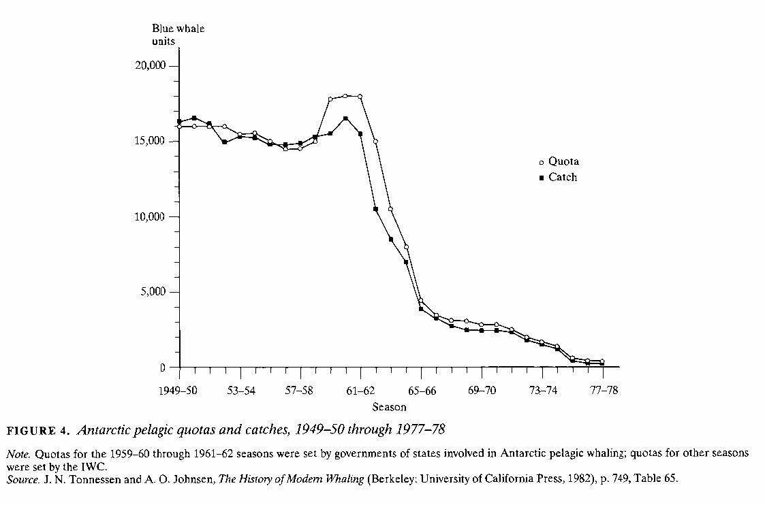
“Having decided to conclude a convention to provide for the proper conservation of whale stocks and thus make possible the orderly development of the whaling industry” (ICRW, 1946)

Slide 12
“Having decided to conclude a convention to provide for the proper conservation of whale stocks and thus make possible the orderly development of the whaling industry” (ICRW, 1946)
Goal

Slide 13
Goal
Failure Relative To Goal

Slide 14
Counterfactual

Slide 15
Counterfactual
Catch LOWER than would have been otherwise, allowing population to recover
But higher population allows MORE catch for longer than would have been possible otherwise
Success Relative To Counterfactual

Slide 16
Both a success and a failure
Counterfactual
Goal
Failure Relative To Goal
Success Relative To Counterfactual

Slide 17
Catch may cause Quota Rather than Vice Versa Implies NO effect

Slide 18
Evaluating Effectiveness
Institutions/regimes/treaties can always be evaluated against TWO definitions of success
#1: “Was goal achieved?” Or “How close did institution come to achieving its goal?”
Compare actual behavior to goal
#2: “Did institution cause behaviors or outcomes different than would have occurred otherwise?”
Compare actual behavior to counterfactual

