Slide 1
Outline
Review theory and predictions
Apply to trade issues, including WTO and EU

Slide 2
Kucik and Reinhardt reading Trade “dumping” and Anti-dumping rules
Dumping: selling goods in foreign country for less than where produced
Anti-dumping: reciprocal response to focus retaliation without undermining cooperation and restarting trade war
Shows relationship of primary rules and response system to problem structure. Anti-dumping rules allow “flexibility” for country to violate rules against specific country if that country violated first against you.
Membership – more countries agree to join
Primary rules – countries that join agree to more stringent rules: agree to lower tariffs more because have flexibility if their interests are harmed
Effectiveness – countries that join are more likely to actually lower tariffs

Slide 3
Institutional type
Regulatory
Coordination, collaboration, and upstream/downstream problems
Procedural
Epistemic/knowledge problems
Programmatic
Positive externalities plagued by incapacities
Generative
Normative problems

Slide 4
Membership
Capacity issues: if some actors can prevent others from bad behavior, membership limited to capable
Limit membership if enforcement problems and uncertainty about preferences
Inclusive membership if distribution problems or symmetric problems

Slide 5
Primary rule system
Ambitiousness
Vague/specific
Depth of cooperation
Basic type of rules
Proscriptions/prescriptions
Incentive issues
Capacity issues
Scope: broad/narrow
Common vs. differentiated obligations

Slide 6
Information system
Strength of information system
Strong: collaboration, up/down, normative, and low inherent transparency
Weak: coordination, high inherent transparency
Type of information system
Centralized?
Self-reporting / monitoring / verification
Enforcement school vs. management school: what is “behavioral model” and how is info to be used

Slide 7
Response system
Response strategies
Altering consequences
Deterrence: increase expected costs of violation
Remuneration: increase expected benefits of compliance
Altering opportunities
Generative: create new opportunities to comply
Preclusive: remove opportunities to violate
Altering perceptions
Cognitive: provide new information that changes perception of best choice
Normative: re-educate regarding values
Reciprocity of response: diffuse / specific
Strong responses if violation tolerance is low
Enforcement school vs. management school: are there effective responses other than enforcement (punishment)? Do rewards, capacity-building, norms work?

Slide 8
Hypotheses re: Problem Structure / Institutional Design
Conflict or deadlock: if relevant actors prefer outcomes of conflict more than alternatives (deadlock), than NO institution forms
Capacities 1: if capacity for BAD behavior depends on others: REGULATORY institution which LIMITS membership to capable states and COMMON obligations to ban behaviors that would allow others to engage in bad behavior
Capacities 2: if some actors lack CAPACITY for GOOD behavior: PROGRAMMATIC institution which EXPANDS membership and DIFFERENTIATED obligations (donors/recipients) and RESPONSE of capacity enhancements (not rewards/sanctions)

Slide 9
Hypotheses re: Problem Structure / Institutional Design
Incentives 1:
Coordination: REGULATORY institution with COMMON obligations and NO response system
Up/Downstream: REGULATORY institution with DIFFERENTIATED obligations and LINKAGE response system
Collaboration: REGULATORY institution with COMMON obligations and RETALIATORY (“reversion”) response system
Incentives 2: if strong incentives to cheat: clearly specified INSPECTION and RESPONSE rules (likely for collaboration & upstream/downstream but NOT coordination)

Slide 10
Hypotheses re: Problem Structure / Institutional Design
Information: if little INFORMATION about consequences of behavior: PROGRAMMATIC or PROCEDURAL institution with weak information / response systems
Norms: if effort by some to instill NORMS in others; GENERATIVE institution has WEAK information/response system (or sanctions if strong pre-institutional norm against behavior)

Slide 11
Hypotheses re: Problem Structure / Institutional Design
Inherent Transparency: if easy to know what other actors have done: WEAK INSPECTION procedures
Response Incentives 1: Strong concern about violations: STRONG and SPECIFIC inspection and response system (or easy withdrawal)
Response Incentives 2: Low concern about violations: WEAK INSPECTION and RESPONSE procedures

Slide 12
Trade: Predictions based on Problem Structure
Institutional type: reg, proc, prog, gen
Membership
Primary rules
Common or differentiated
Specificity
Information system: self/monitor/verify
Response system

Slide 13
Problem Structure, Institutional Design, & Trade
 | GATT/ WTO | EU (but could do Mercosur)
Q1: Conflict/deadlock | Cooperation possible (not deadlock) | Cooperation possible (not deadlock)
Q2: Number of actors | Many: membership by any state | Few: membership limited to region
Q3: Capacity | Equal capacities so common obligations | Equal capacities so common obligations
Q4: Incentives | Collaboration so regulatory institution | Collaboration so regulatory institution
Q5: Information | Problem understood so no research arm | Problem understood so no research arm
Q6: Values | All states agree on free trade as good | All states agree on free trade as good
Q7: Inherent transparency | High for tariffs so weak inspection | High for tariffs so weak inspection
Q8: Response incentives | Strong incentives and reciprocity works | Strong incentives and reciprocity works

Slide 14
Understanding the chart:
Sugar will “flow” into United States from countries whose sugar costs less
Red number is how much sugar costs in each country
Height of BLOCKS is how much sugar consumers can buy on their budget
Height of WALLS is tariff needed to keep cheap sugar out
Country D grows sugar for $1 per pound
Country B grows sugar for $4 per pound
TARIFFS
United States grows sugar for $3 per pound
And Consumers PAY $3 per pound
Country A grows sugar for $5 per pound
Country C grows sugar for $2 per pound
High tariffs keep cheaper sugar out, protecting our sugar farmers’ jobs
but they make the price of sugar higher than if we imported it.

Slide 15
Understanding the chart:
Sugar will “flow” into United States from countries whose sugar costs less
Red number is how much sugar costs in each country
Height of BLOCKS is how much sugar consumers can buy on their budget
Height of WALLS is tariff needed to keep cheap sugar out
Country D grows sugar for $1 per pound
Country B grows sugar for $4 per pound
United States no longer grows sugar
They import it from Country D And PAY $1 per pound
Country A grows sugar for $5 per pound
Country C grows sugar for $2 per pound
REMOVING Tariffs kills OUR Sugar industry and jobs but lowers price and
increases sugar consumed AND creates more sugar-growing jobs in Country D

Slide 16
Global free trade and WTO
Global free trade obstacles
Consumers don’t benefit enough to mobilize
Export sector may be weaker than import-competing sector
ONGOING opposition from import-competing sector
Costs of free trade are NOW and CLEAR, benefits of free trade are FUTURE and UNCERTAIN
Transition costs are not small
If protectionists win, then retaliation by others creates trade war
Key features: collaboration problem, no incapacity, inherent transparency, violation tolerant, strong response incentives

Slide 17
Global Free Trade and the WTO
Some things we can explain
Interests → success on manufactured but not agriculture
Incentives → strong incentives to cheat
Transparency → no need for inspections to catch tariff violations, so easier to get agreement but subsidies challenging
Response incentives: desire to retaliate while maintaining free trade → Dispute Settlement Panels

Slide 18
Free Trade Zones and the European Union
Basic problem: free trade zones require
Common market: Equalize and lower tariffs within
Customs union: Equalize tariffs without
Slightly different problems from WTO because need a customs union relative to non-EU states

Slide 19
Understanding the chart:
Creating the European Union as a free trade area required two parts
Customs Union (agreement to impose common tariffs on outsiders)
Common or Single Market (agreement to remove tariffs on insiders)
Notice that this is true among 50 states in the United States
Country D grows sugar for $1 per pound
Country B grows sugar for $4 per pound
Customs Union: All countries impose SAME TARIFF on non-EU sugar
European Union grows sugar for $3 per pound
And Consumers PAY $3 per pound
Common Market:
No sugar tariffs inside EU
Country A grows sugar for $5 per pound
Country C grows sugar for $2 per pound

Slide 20
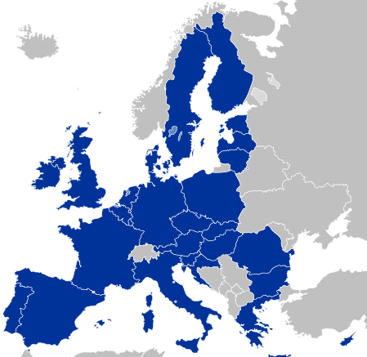
European Union: Customs Union & Common Market

Slide 21
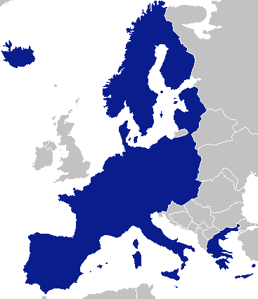
Schengen Area: Border Control & Human Rights

Slide 22
European Union Current Problems
Brexit presents standard problem of free trade
UK wants low tariffs for their EXPORTS to others
UK wants high tariffs on IMPORTS from others
EU says, “Okay, but why should we do that?”
Where should the border be? Ireland/Northern Ireland problem

