Slide 1
Course Evaluations
Please fill out the course evaluation for this course – I value your feedback on the course and future students will benefit from the feedback you provide.
Thanks very much
for doing your Course Evaluation!!!

Slide 2
Final Exam – Takehome Question
International organization involves efforts by states to resolve the problems they face. Select TWO (2) examples of international problems, 1 from each of 2 different issue areas: security, international political economy, human rights, and environment. Describe differences and similarities between your two examples in terms of a) their problem structures, b) how those problems influence the international institutions states create, and c) how both of those sets of factors influence the effectiveness of those institutions. Write a well-structured and coherent essay that uses the theories, concepts, analytic techniques, and evidence from readings & lectures.

Slide 3
PS420 Post-Test
16 minutes // 4 minutes per question
Get out sheet of paper
Put name on it

Slide 4
PS420/520 Pre-Test 16 minutes / 4 minutes each
Problem Structure: What types of problems do countries face that require international cooperation? Describe at least two different kinds of problems that countries face.
Institutional Design: Why is it hard for countries to cooperate internationally? What types of international institution do countries create to promote such cooperation? Describe at least two different kinds of institutions that countries create. If possible, identify how problems and solutions “go together.”
Institutional Effects: How do we know an international institution has been effective? Identify 3 types of factors that make one institution “work” while another one fails.
Issue Area Differences: Name at least three issue areas in which countries seek to cooperate internationally. Do the answers to the previous questions differ across these issue areas?

Slide 5
Review of Institutional Effectiveness

Slide 6
Effectiveness and Counterfactuals
Observe certain outcome
Generate counterfactuals that try to match everything except the regulation being in place. So, try to control for:
Characteristics of country
Characteristics of activity involved
Characteristics of context, i.e., international environment
Note, these are same as Jacobson/Brown Weiss

Slide 7
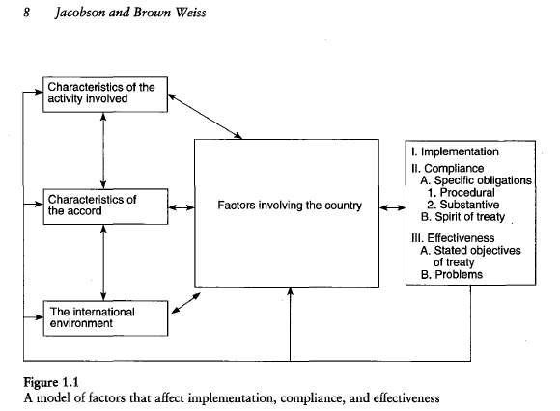

Slide 8
Institutional dynamics: how institutions change over time
Institutions change and adapt
Change in problem structure
Expand their scope, e.g., EU, GATT/WTO,
Improve design, e.g., oil pollution, ozone
Institutional resilience depends on being able to adapt to new circumstances
Processes of change: organic, negotiated, imposed
Internal (endogenous) vs. external (exogenous) change

Slide 9
Institutional interplay, linkage, overlap, and complexes
Institutions exist in relationship to other institutions
Human rights and environment conventions
Interplay among various trade institutions
Clustered institutions/regimes
Sources of problems often overlap so often need coordination of institutions
Take advantage of synergies and avoid redundancies and conflicts

Slide 10
Alternatives to International Agreements
Industry self-regulation
Coordination between NGOs and corporations
Transparency International working on bribery codes
NGOs working with MNCs for human rights and environmental regulation
Selective self-regulation: “coalition of the willing,” others may follow
“Islands of integrity” with respect to bribery
Green nations move first
Regulation by information / disclosure
Transparency International actions
Human rights NGOs
Direct action partnerships and networks
Debt for nature swaps among banks, governments, and NGOs
NGOs working with corporations to provide drugs in various countries

Slide 11
Problem Structure and Institutional Effectiveness
HARDER problems less likely to be effective
Easy:
COORDINATION: Big effect on shallow problems
EPISTEMIC: pooling informational resources that are cheap AND states have interests in pooling
Medium:
UPSTREAM/DOWNSTREAM: hard to resolve but structure generates careful rules that make likely to succeed
PEPI: structure leads to careful rules that tend to be “incentive-compatible”
Hard group:
COLLABORATION: all have incentives to contribute AND cheat
NORMATIVE problem: changing norms is very hard

Slide 12
Problem Structure and Institutional Effectiveness
Inherent transparency
LESS inherent transparency, more likely institution will NOT be effective
Response incentives
LESS violation tolerance, more likely institution WILL be effective
STRONGER response incentives, more likely institution WILL be effective

Slide 13
Institutional Design and Institutional Effectiveness
Institutional type:
Procedural/programmatic – regulatory – generative
Membership: more states, LESS effective
Primary rule system
MORE specific, MORE effective
Common vs. Differentiated: which is more effective is unclear and depends more on how much the rules require relative to counterfactual behavior
Information system: clearer, MORE effective
Response systems:
Facilitative, MORE effective than
Clear/specific MORE effective

